Slide 1
Burke
Notable BayWEB Supporters
California Senator, Dianne Feinstein California Senator, Mark Leno
U.S. Representative, Michael M. Honda
U.S. Representative, Zoe Lofgren Marin County Sheriff, Robert T. Doyle
Marin County Fire Chief, Ken Massucco
Marin County Public Works Director, Farhad Mansourian
Marin County Superintendent of Schools, Mary Jane
Slide 3

Slide 2
Broadband Technology
The NTIA grant is funding the Bay Area Wireless Enhanced Broadband (BayWEB) program through the Broadband Technology Opportunities Program (STOP).
Provides support for the deployment of broadband infrastructure (Internet and high speed data) to connect community anchor institutions such as schools, libraries, hospitals, and public safety facilities.
Deploying public safety and public access wireless broadband networks in the San Francisco Bay Area.
•
•
•
Slide 4

Slide 3
Slide 5

Slide 4


Slide 5
Grant Application Summary
Project cost
Grant amount requested by Motorola from NTIA $50.6M Motorola match $21.SM
Key components
Public Safety LTE network, 193 Sites
Uses public assets (sites, towers, backhaul, space, power)
Owned, managed CORE (Central computer equipment)
Public broadband access network (5.2, 5.4 GHz) 193 sites
Unlicensed spectrum for open access
7 Internet Service Providers (ISP) as partners
•
•
•
Slide 7

Slide 6
Public access network backhaul is completely separate from LTE network
- No backhaul is shared
Design Assumptions
Agencies will provide "installation ready" sites for deployment
Physical space is available at each site to accommodate LTE equipment
Expected to be 12,000 concurrent users on the LTE system
Uniform user distribution across each county
•
•
•
•
•
Slide 8

Slide 7
Deploy broadband services at 200 existing public safety sites that will support almost 50,000 public safety users and over 500 public safety facilities with speeds of up to 6.5 Mbps.
The coverage area for this network encompasses nearly 2.5 million households.
Serve as a demonstration project for national implementation of 700 MHz interoperable public safety wireless broadband networks.
Offer wholesale wireless capacity to Internet service providers in the Bay Area to facilitate more affordable and accessible broadband service for up to 2.5 million households and 186,000 businesses by enabl ing local Internet service providers to utilize the project's open network.
Project Summary
BayWEB proposes to:
-
-
•
•
•
Slide 9

Slide 8
Applications
Examples include:
  Mobile Data Terminals
  Real-time mobile video for field officers;
  Geolocation information about damage, dangers, hazardous materials, road conditions;
  Personnel and vehicle location;
  Amber Alert file transfers,
  Virtual command centers.
The Bay Area Regional Interoperability JPA will manage quality-of-service, access, interoperability, policy, and system management issues for the public safety network.
Slide 10

Slide 9
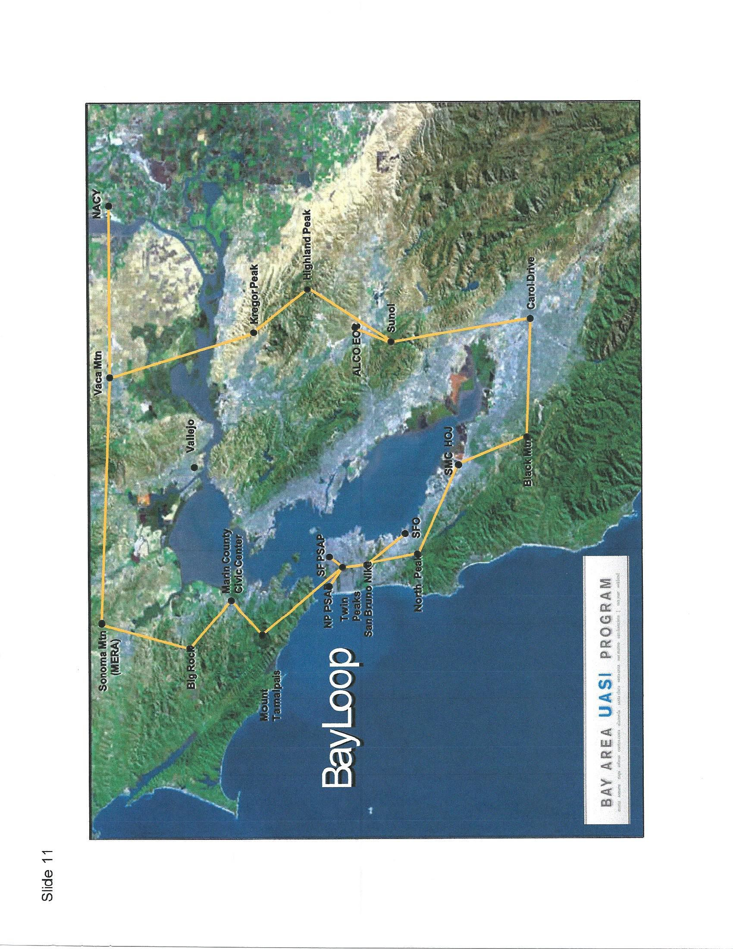

Slide 10
Agency Sites
Marin
  Total sites: 23
San Francisco
  Total sites: 19
San Mateo
  Total sites: 30
Santa Cruz
  Total sites: 4
Alameda County
  Total sites: 47
Contra Costa
  Total sites: 18
Solano
  Total sites: 6
Napa
  Total sites: 4
Sonoma
  Total sites: 13
Santa Clara
  Total sites: 29
Slide 12

Slide 11
Mt. Tamalpais
MERA leases on a monthly basis from American Tower Corporation
A separate lease will need to be negotiated
Mt. Burdell
MERA leases on a monthly basis from American Tower Corporation
A separate lease will need to be negotiated
Big Rock Ridge
MERA leases on a monthly basis from C&C Equipment Company
A separate lease will need to be negotiated
San Pedro Ridge
MERA leases on a monthly basis from C&C Equipment Company
A separate lease will need to be negotiated
Under
Consideration
Proposed Sites
•
•
•
•
13
Slide

Slide 12
Proposed Sites Under
Consideration
Pt. Reyes Hill
  MERA leases from FAA
  A separate lease will need to be negotiated
Stewart Point
  MERA leases from Martinalli Family
  A separate lease will need to be negotiated
Bay Hill Road
  MERA leases from AT&T
  A separate lease will need to be negotiated
Mt. Barnabe
  MERA site at County Fire lookout
  A separate lease will need to be negotiated
Slide 14

Slide 13
Under
Consideration
Dollar Hill
MERA site owned by City of San Rafael
A separate lease will need to be negotiated
Forbes Hill
MERA site at water tank owned by MMWD
A separate lease will need to be negotiated
Proposed Sites
Crest Water Tank
North Marin Water District
A lease will need to be negotiated
•
•
•
15
Slide

Slide 14
Proposed Sites Under
Consideration
Pt. Reyes Fire Station
  County fire station
  A lease will need to be negotiated
Throckmorton Ridge Fire Station
  County fire station
  A lease will need to be negotiated
Southern Marin Fire Station 9
  Southern Marin Fire
  A lease will need to be negotiated
Slide 16

Slide 15
Proposed Sites Under
Consideration
Novato Fire Station 3
  Novato Fire District
  A lease will need to be negotiated
Corte Madera Fire Station 1
  Corte Madera Fire
  A lease will need to be negotiated
Sausalito Fire Station 2
  No longer a fire station
  City of Sausalito
  A lease will need to be negotiated
Slide 17

Slide 16
Sites Previously Considered
Mill Valley PD
  Site not viable
Tomalas
  Site not available
Hicks Valley
  Not a viable site, No backhaul
Novato 4
  Replaced by Crest and Novato 3
Novato 5
  Replaced by Crest and Novato 3
Corte Madera 14
  No benefit over existing sites
Tiburon 11
  Site removed by Agency
Slide 18

Slide 17
Sites Previously Considered
Larkspur 16
  Site removed by agency
Mill Valley 17
  Removed by Agency
Cypress Ridge
  Site not viable
Skywalker Verizon
  Verizon cell site
  Motorola negotiations with Verizon have stopped
Mill Valley OT Verizon
  Existing Verizon site
  Motorola negotiations with Verizon have stopped
Sugarloaf
  Site not viable
Slide 19

Slide 18
Governance
Any revenue generated must be reinvested into BayWEB during the Grant Performance Reriod.
Policy decisions around that reinvestment.
- Revenue may be reinvested to provide additional sites for improved coverage (underground, in building)
•
•
Slide 20

Slide 19
Agency Benefits
700 Mhz mobile data system dedicated to Public Safety
Anticipated cost reduction
Coverage in less populated areas critical to public safety
High priority maintenance program
Possible future VOiP connections
Slide 21

Slide 20
Agency Cautions
Monthly cost is uncertain at this time
Ownership I maintenance commitment after ten years
Upgrade costs due to technology
Site lease costs
Limited bandwidth - Some applications may not be allowed
Slide 22

Slide 21
Costs to Agency
Site upgrades
New vehicle installation costs
New modems in vehicles
Application interface costs
On-going PG&E power
On-going site leases
•
•
•
•
•
•
Slide 23

Slide 22
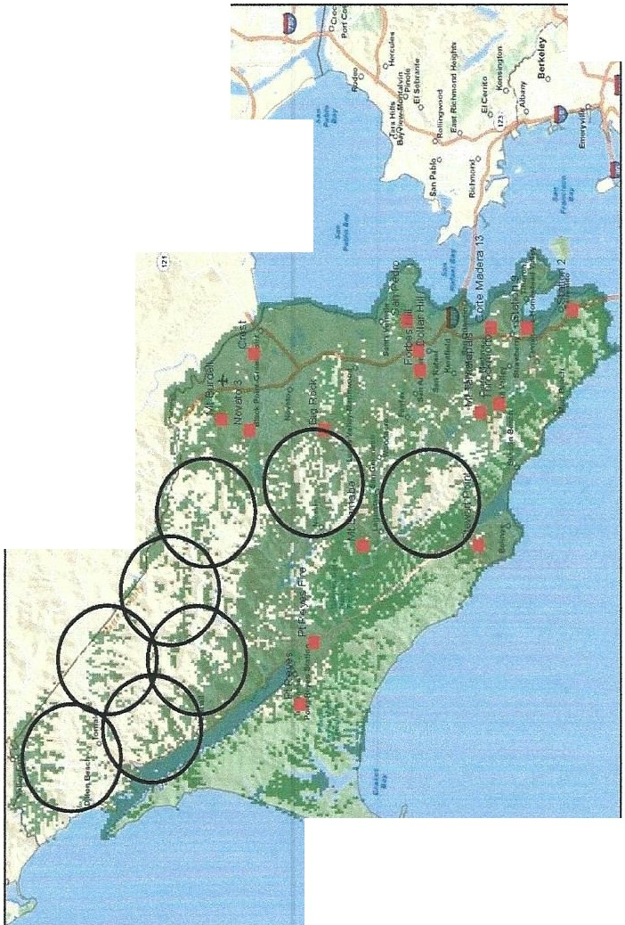

- .:
V;,.Uo
,
..,
•..e....:\
2884430867 20 cool 17
;'t...
I
+
•-
,,,.=:
·
"
:--..,
Coverage Maps
Marin County
Ffo!.....M.o.tS.p.1._/":ft£,_...,.ap..._...l.o:'
o o._
-.
H-fdre4 2 1474 0 Por!lon(s)Qf GIS Source Dais Copyngh[CJ2009 ESRI.ANO. TANA. ESRI Japan .UNEP-WCMC
he.ti-\
Inbound Coverage 256k UL
/.
-1--""'4
G MOTOROLA
6 Mires
I I I I I I I I I
1 Inch s 5.45 mlles
ht:.ficOo,.,,
O 1,5 3
JI.Kl 29. 2011
Slide 24

Slide 23
Next Steps
Join BayWEB JPA
Complete site review
Define site upgrade funding sources
Complete site lease requirements
Review environmental site requirements
Obtain permits as required
Begin site development
Slide 25

